Slide 1


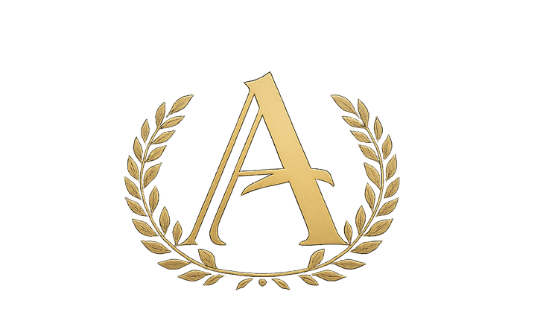
AURELIUS CAPITAL GROUP
01
INSTITUTIONAL REAL-WORLD ASSET ORIGINATION
2026
DISCREET • NON-CUSTODIAL • INSTITUTIONAL

Slide 2



WHO WE ARE
2026
Aurelius Capital Group is an independent firm focused on the origination and strategic introduction of income-producing commercial real estate assets to institutional tokenization and capital structuring partners.
We operate as a non-custodial, non-issuing intermediary, aligning asset owners with regulated platforms capable of delivering structured liquidity and fractional ownership solutions.
02

Slide 3
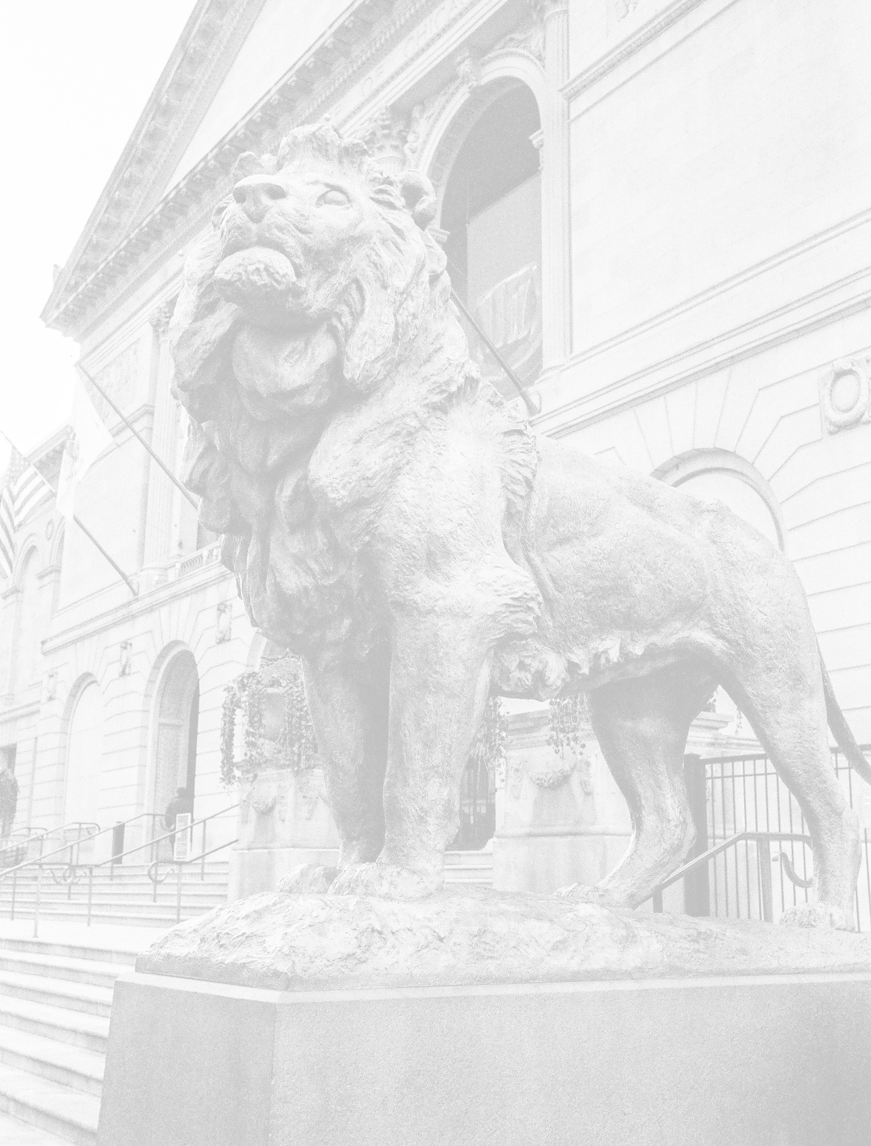

CHALLENGES & SOLUTIONS
2026
THE CHALLENGE FACING PROPERTY OWNERS
Commercial real estate is inherently illiquid
Traditional refinancing is restrictive and cyclical
Full asset sales often force premature exits
Access to global capital remains inefficient
Owners need liquidity without losing control.
A MODERN CAPITAL STRUCTURING SOLUTION
Tokenization allows property owners to convert a defined portion of a real estate asset’s economic value into digital units, enabling partial liquidity, improved capital flexibility, and long-term ownership retention without selling the entire property.
Aurelius Capital Group operates at the origination layer, ensuring only qualified assets reach institutional partners.
03

Slide 4

WHAT WE DO
2026
WHAT WE DO NOT DO
We do not custody assets or funds
ASSET ORIGINATION
Identify and screen income-producing commercial real estate assets with clear ownership and operating history.
We do not issue tokens or securities
STRATEGIC INTRODUCTIONS
Introduce qualified assets to regulated tokenization platforms, funds, and capital partners.
We do not manage investments or portfolios
We do not solicit retail investors
ALIGNMENT & EXECUTION SUPPORT
Facilitate early-stage structuring discussions without custody, issuance, or advisory authority.
We do not provide legal or tax advice
04
All regulated activities are performed by licensed third parties.

Slide 5

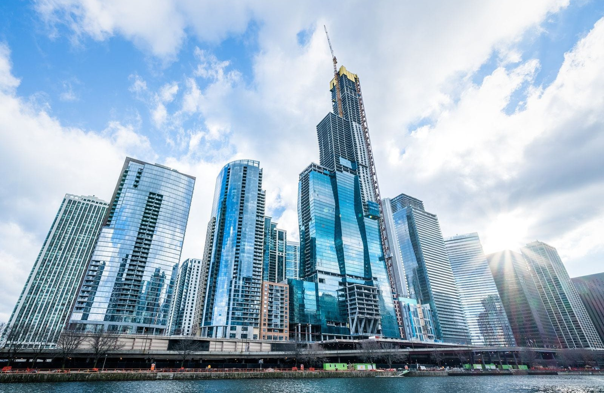
ASSET FOCUS
2026
Primary Focus:
Income-Producing Commercial Real Estate
Criteria:
Asset value: $2M–$20M
Stabilized or near-stabilized cash flow Clear ownership structures
Offices, industrial, and multifamily assets
05

Slide 6


HOW TOKENIZATION WORKS (SIMPLIFIED)
2026
1. Property is held in a legal entity
(SPV/LLC)
A portion of economic rights is defined (e.g., 30–50%)
Tokens are issued by a regulated platform
Capital is raised from qualified investors
Owner retains control and remaining
ownership
06

Slide 7


BENEFITS FOR PROPERTY OWNERS
2026
Unlock liquidity without selling the asset
Reduce dependence on bank refinancing Maintain operational control
Share risk with aligned equity capital Create future optionality
WHO THIS IS DESIGNED FOR
Owners seeking partial liquidity Long-term holders, not forced sellers Assets with real operating history
Principals open to modern capital solutions
07

Slide 8

WHY PARTNERS WORK WITH US
2026
Why Platforms & Capital Partners Engage
ACG
Pre-screened institutional-grade assets Clean ownership and realistic sizing Reduced sourcing friction
Aligned, long-term participation
Risk & Compliance Discipline
Non-regulated advisory role Clear contractual disclaimers No discretionary authority No handling of client funds
Conservative structuring approach
08

Slide 9

FREQUENTLY ASKED QUESTIONS
2026
OWNER Q&A (SELECTED)
Q: DO I LOSE CONTROL OF MY PROPERTY?
A: NO. OWNERS TYPICALLY REMAIN MANAGING MEMBERS. Q: WHAT IF THE PROPERTY VALUE CHANGES?
A: GAINS AND LOSSES ARE SHARED PROPORTIONALLY. Q: IS THIS DEBT?
A: NO. MOST STRUCTURES ARE EQUITY-BASED. Q: CAN TOKENS BE SOLD LATER?
A: IN SOME CASES, SUBJECT TO REGULATION.
09

Slide 10
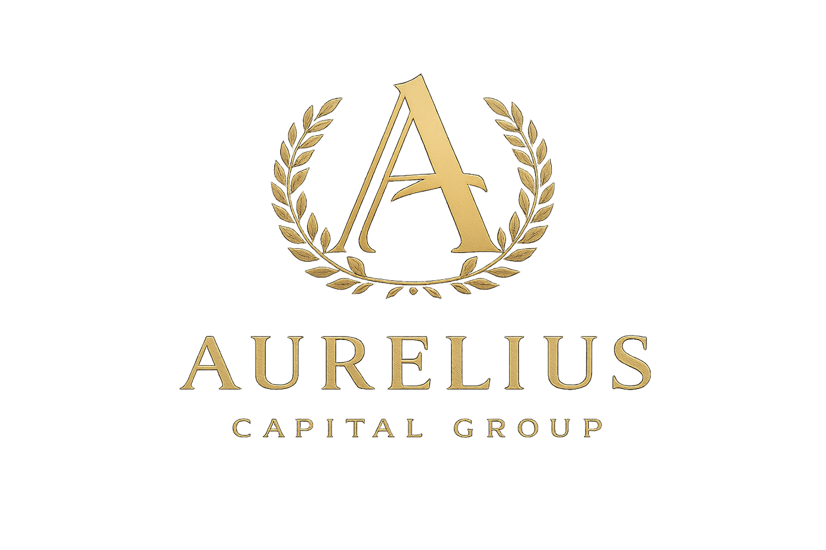

2026
The first step is a confidential, no-obligation discussion to determine whether a property qualifies and whether tokenization is an appropriate solution
CONTACT: CONTACT@AURELIUSCAPITALGROUP.COM
10
Discreet Origination for Institutional Capital

